Slide 1
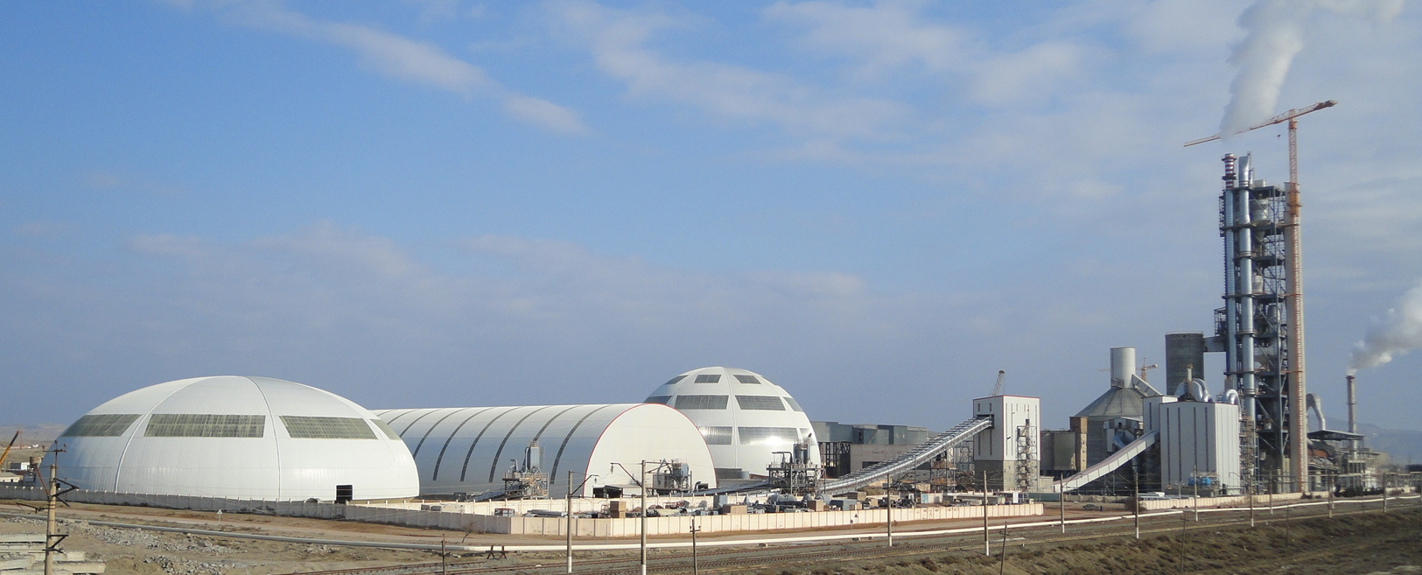
Product Optimization
PPE Course

Slide 2
Objectives
Understand the relevance of product optimization
Know the systematic approach for product optimization
Have an overview on the different factors influencing cement performance
To familiarize with adequate control parameters
2

Slide 3
Agenda
Basic Aspects for Product Optimization
4
The Product Optimization Decision tree
11
Clinker Quality
13
Set Regulator
28
Mineral Components
48
Cement Grinding
60
Cement Additives
75
Conclusions
84

Slide 4
Basic Aspects for Product Optimization

Slide 5
Optimization of the final product contributes to cost reduction, customer satisfaction and sustainable performance
Better cost management
Reduction of production costs
Increase of production capacity
Lower or delayed need for investments
Compliance with market requirements
Improvement of product quality
Product differentiation
Sustainable ecological performance
Reduction of CO₂-output
Extension of raw material resources
5

Slide 6
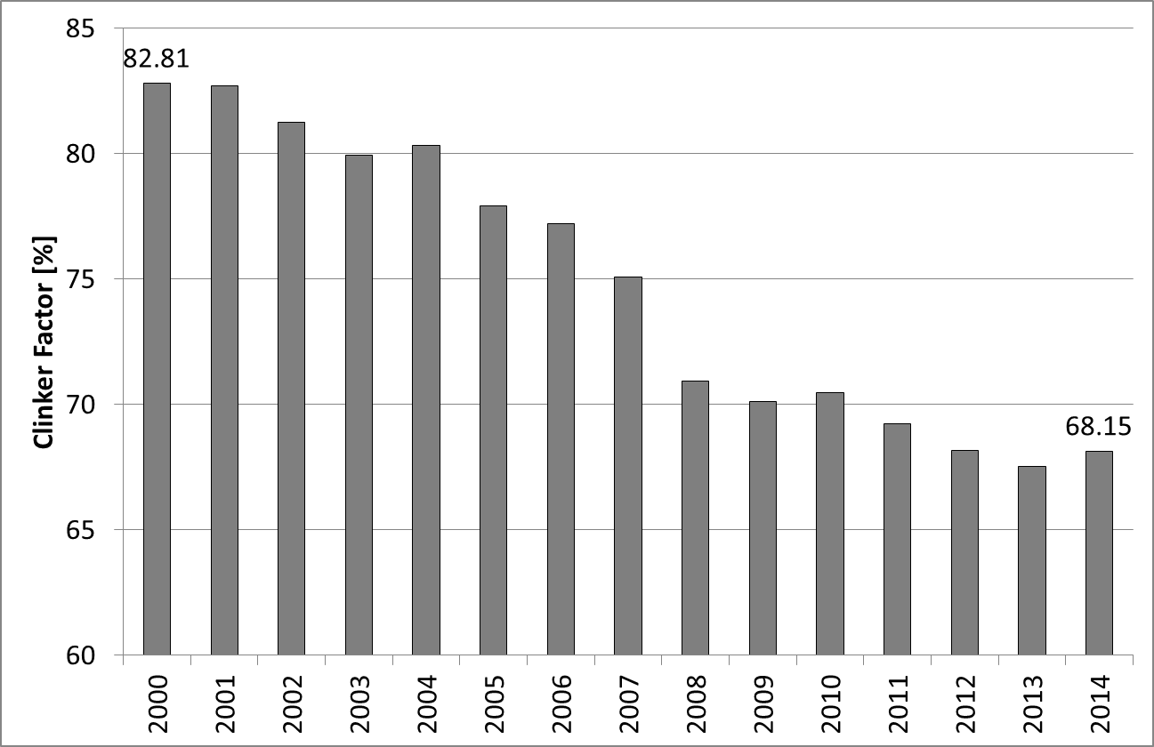
An important indicator for product optimization is the reduction of the clinker factor
Information from the CO₂ inventories of the group
6

Slide 7
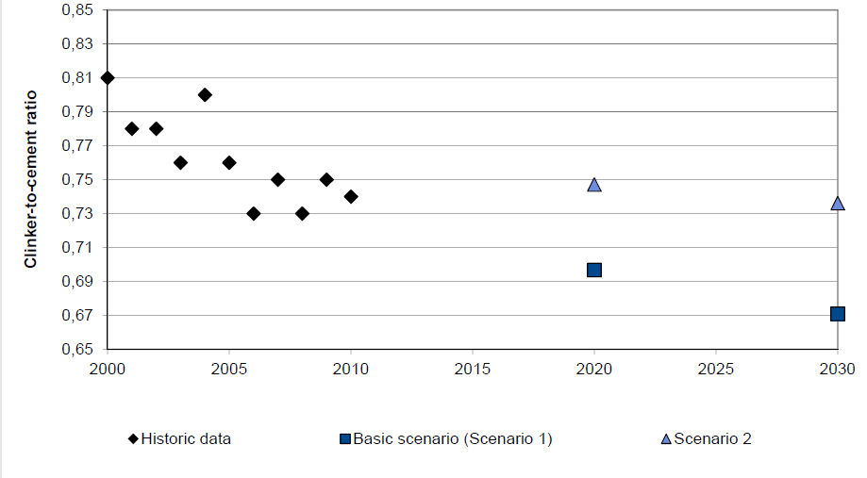
Clinker factor development in Germany (Source VDZ), based on an extrapolated product portfolio
Stable slag availability, trend to higher fineness, replacement of CEM I by CEM II
Reduced slag availability (-25%), thus reduced CEM II-S production
7

Slide 8
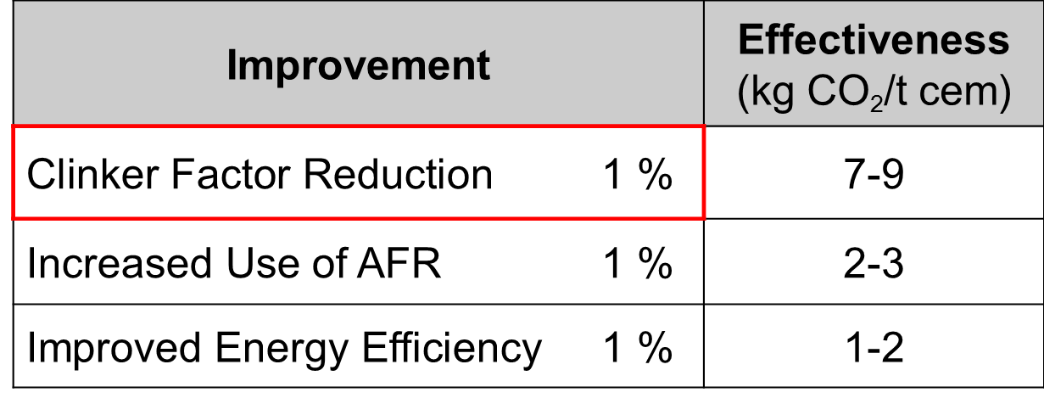
The reduction of the clinker factor allows to decrease significantly the specific CO₂ emissions per ton of cement
To reduce the clinker factor is the most effective measure and represents the highest potential for CO₂ reduction
8

Slide 9
There are several threats for the further reduction of the clinker factor in the Group
Level | Threats
Business Plan, Budget | MIC availability / costs Direct use of MIC by customers Prescriptive instead of perform oriented standards Market tendency to high early strength cements
Marketing (“daily operation”) | Quality race amongst competitors Missing experience / acceptance for CC
Manufacturing (“daily operation”) | Low early strength of composite cements Lower clinker quality / uniformity due to use of AFR Resistance to clinker mineralization Technical constraints
9

Slide 10
Pre-requisite for the product optimization is a clear definition of the product portfolio and quality requirements
Task:
Product Mix Definition Responsibility:
Marketing &
Production
Definition of Product Mix and
Product Quality Requirements
Market requirements /strategy
Cement standards
Availability of MIC’s
Raw material situation
Production facilities
Task:
Product Optimization
Responsibility:
Production
Achievement of Product Requirements
at Minimum Operation Cost
Performance improvement of intermediate and final products
Process optimization
Optimal cement design
10

Slide 11
The Product Optimization Decision tree

Slide 12
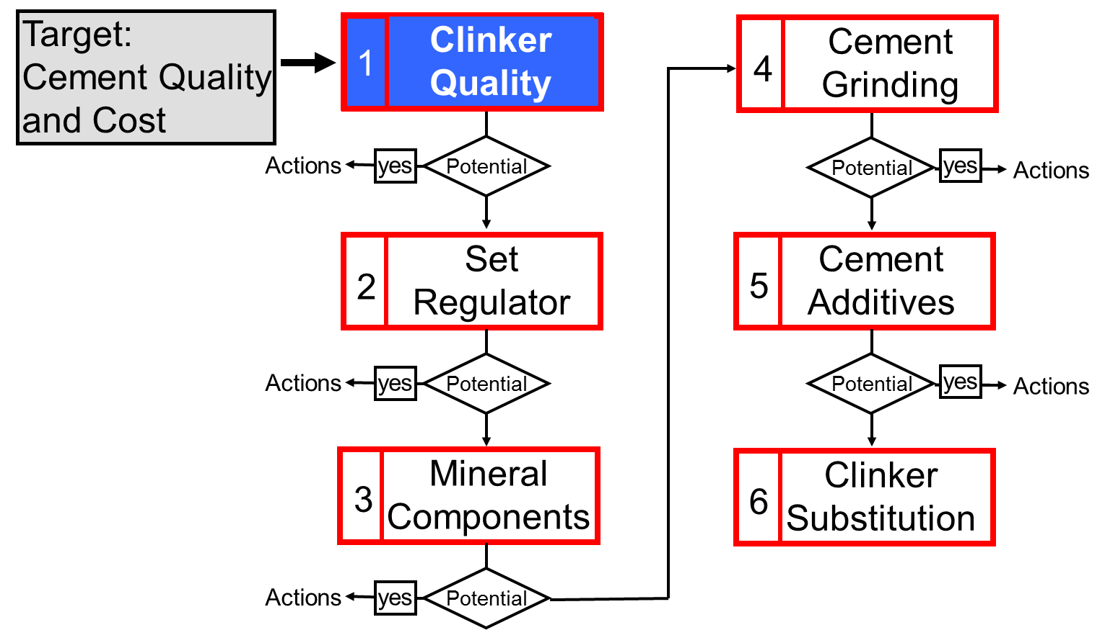
Systematic approach for product optimization
12

Slide 13
Clinker Quality

Slide 14
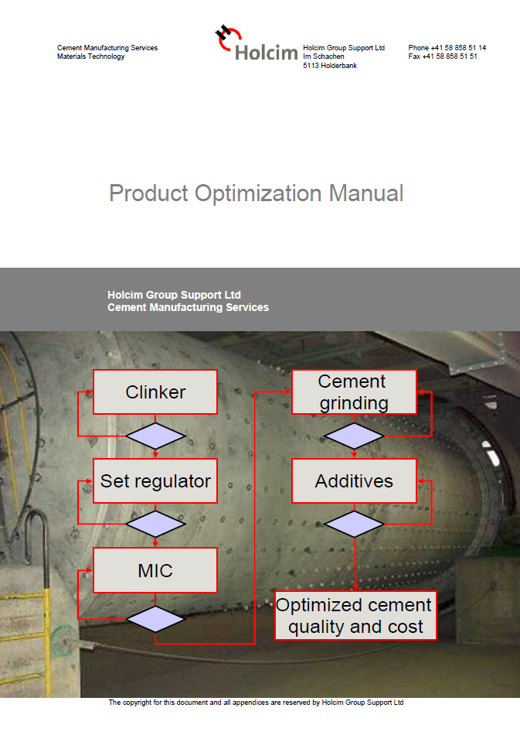
The Product handbook can be found on Google Drive

Slide 15
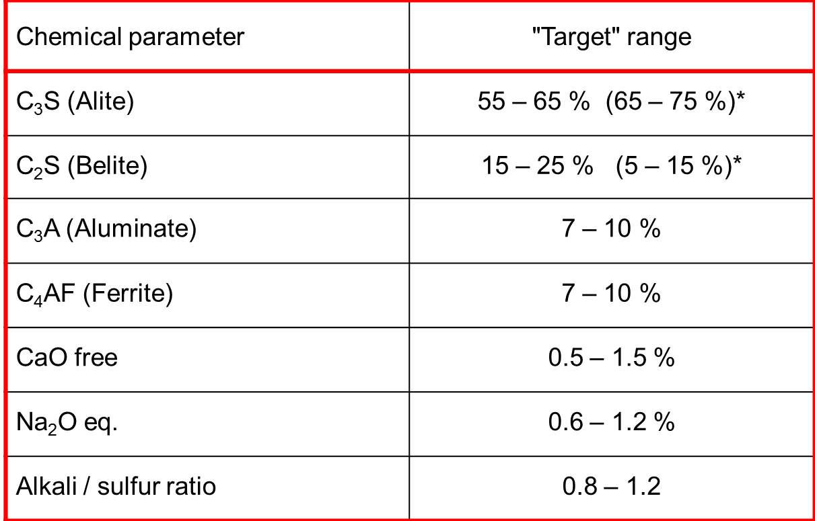
C₃S, C₃A, alkalis and sulfur determine to a great extent the strength potential of the clinker
* mineralized clinker
15

Slide 16
Influence of clinker minerals on cement properties
Clinker phase | Name | Typical Content (%) | Early strength | Final strength | Setting time | Water demand | Sound-ness
C₃S | Alite | 60 – 70 | ä | ä | - | - | -
C₂S | Belite | 10 – 20 | æ | ä | - | - | -
C₃A | Aluminate | 7 – 10 | ä | æ | æ | ä | -
C₄AF | Ferrite | 7 – 10 | (æ) | (ä) | - | (æ) | -
CaO free | Free lime | 0.5 – 1.5 | ä | - | æ | - | æ
MgO | Periclase | 0.6 – 1.2 | - | - | - | - | æ
Alkali sulphates |  | 0.6 – 1.2 | ä | æ | - | ä | -
ä increase æ decrease - no effect
16

Slide 17
Result of HTEC reactivity testing: C₃S is main driver for the strength development at all ages
Good range of C₃S
17

Slide 18
42% of Holcim clinkers are undersaturated in sulfur
In 2010 65% of the clinkers of the Group were under-saturated in sulfur
Alkali excess
molar A/S = 1
Sulfur excess
ATR 2014
18

Slide 19
Example: Alkali sulfates and strength potential

Slide 20
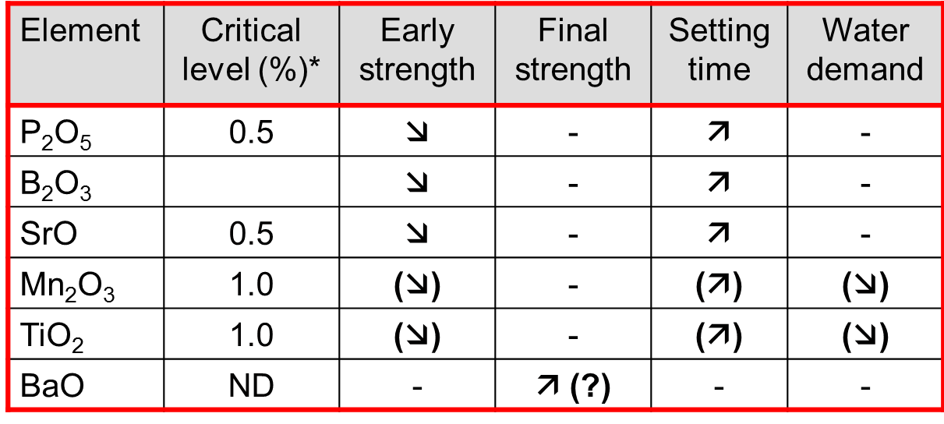
Other minor elements can impact the clinker properties
Belite stabilization
Increased Ferrite
ä increase æ decrease - no effect
*On clinker basis; level may vary with specific plant conditions and requirements
20

Slide 21
Heavy metals have in general not a significant impact on clinker quality
Comments on some specific elements:
Cr: Effect on health & safety of the final product (chromate eczema) if present as Cr (VI)
Zn: Set retardation and low early strength at concentrations of 0.5% in clinker (not relevant for practice)
V: Possible increase due to use of special Petcoke quality, concentrations, however, still too low for relevant effect.
For further reference regarding typical heavy metal contents, consult the Memo 07-14135-Trace Elements on Google Drive.
21

Slide 22
Besides the chemical composition, certain process measures have be followed to ensure good clinker quality
Raw Material Prep.
and Grinding
Maximize / Optimize:
Raw meal homogeneity
Raw meal fineness
Coarse fuels (AFR!)
Avoid:
Overheating
Lazy long flame (flat temp. profile)
Sulfur cycles
Clinker dust formation
“Reducing” conditions
Slow clinker cooling
Clinker Burning
and Cooling
22

Slide 23
Influence of raw meal preparation
Fineness:
The smaller the particles and the closer they are, the smaller the diffusion distances. With excessive particle size or distance between two reactants, the reactions cannot take place within a reasonable time.
Homogeneity:
Insufficient raw meal homogeneity can cause an oversaturation of carbonate or siliceous particles in certain areas.
If there is a lack of limestone components and a concentration of siliceous components, a cluster of belite occurs.
If in contrary there is a surplus of carbonate component, the CaO which has not reacted remains as free lime clusters.
23

Slide 24
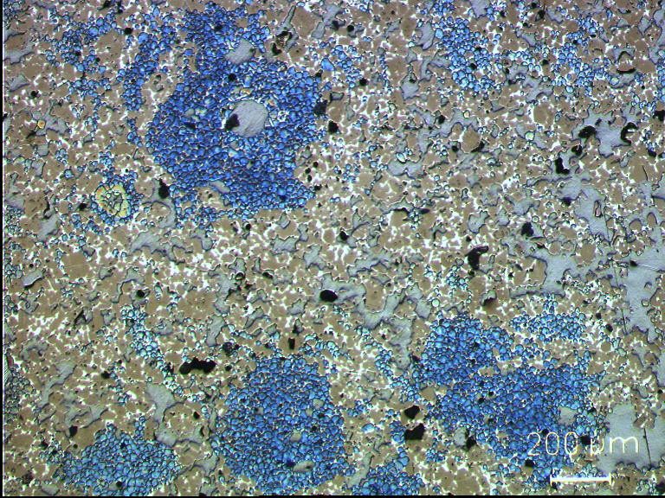
Proper raw meal preparation is crucial to achieve a fine and homogeneous clinker microstructure and a good reactivity
Bad: Coarse & heterogeneous microstructure (raw meal too coarse and not uniform)
Good: Fine & homogenous clinker microstructure (adequate raw meal fineness & uniformity)
Legend: Alite is brown, belite is blue.
24

Slide 25
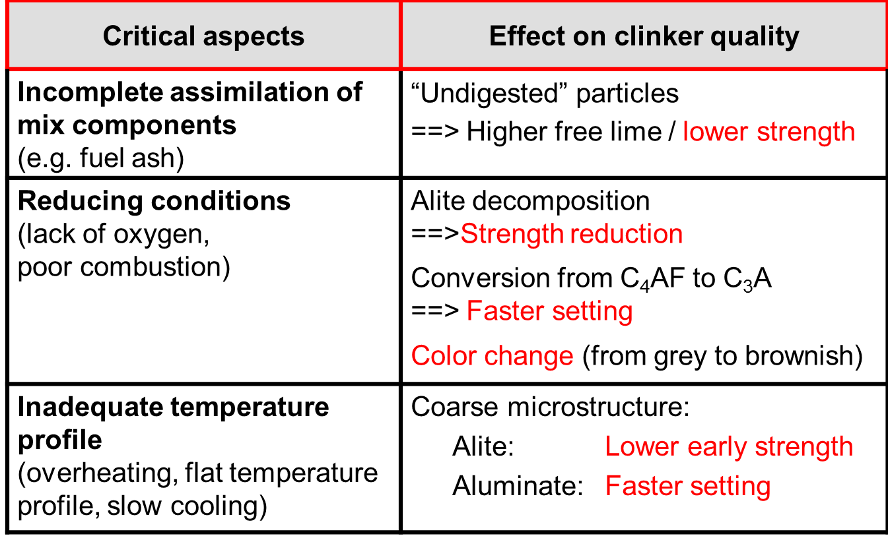
Influence of burning conditions on clinker quality
25

Slide 26
Process and quality control of AFR and of kiln operation is crucial to ensure the reactivity of the produced clinker
Example Höver: Increase of TSR went along with reduction of early strength
1 day strength development CEM I 52,5R
Use of AFR poses more risks for process problems in the kiln due to their less favorable characteristics regarding ease of combustion.
Critical aspects to be controlled are the "ash” integration from AFR, reducing conditions and inadequate temperatures profiles in the kiln.
26

Slide 27
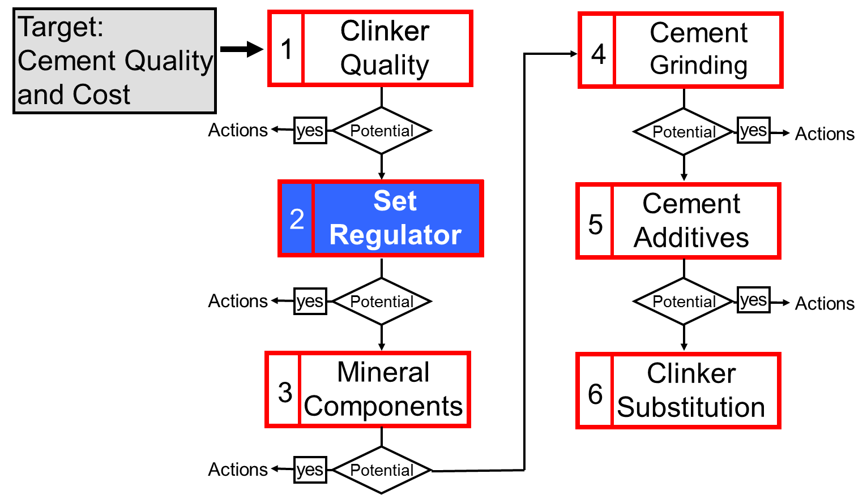
Systematic approach for product optimization
27

Slide 28
Set Regulator

Slide 29
The set regulator plays an essential role regarding cement performance
Type (Gypsum / Anhydrite) and dosage of calcium sulfate has an effect on:
Setting behavior
Strength development
Flowability / storage stability
Use of industrial gypsum implies advantages and disadvantages:
lower cost
high moisture leads to handling problems and requires sufficient drying capacity of the mill system
possible presence of minor elements prolonging setting times and reducing strength
29

Slide 30
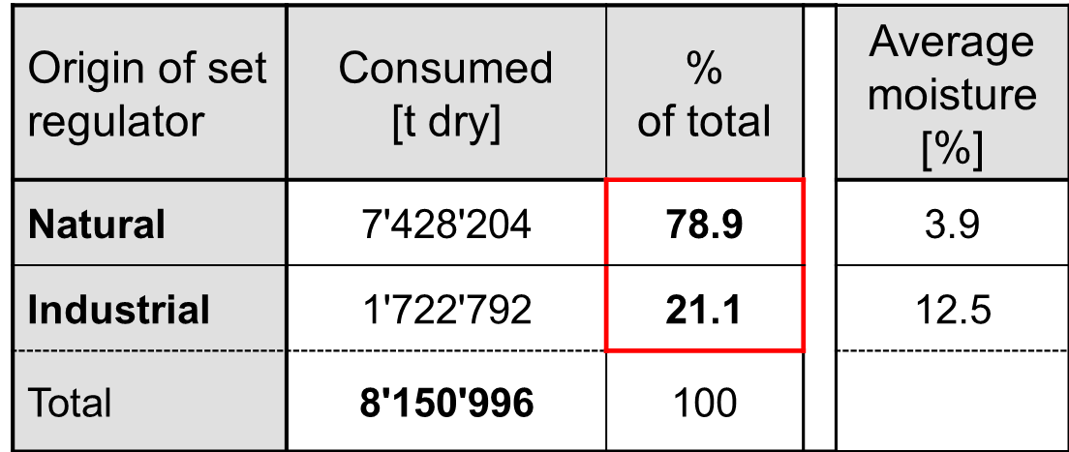
Industrial gypsum is widely used within the Holcim Group
Source: ATR 2009
30

Slide 31
Industrial gypsum sources
Type | Source | Impurities
Desulfogypsum | Flue gas desulphurisation | SO₃²⁻, Cl
Phosphogypsum | Fertilizer and phosphoric acid production | P₂O₅, F
Fluorogypsum | Hydrofluoric acid production | CaF₂
Borogypsum | Boric acid production | B(OH)₃
Titanogypsum | TiO₂ production | TiO₂, Fe(SO)₄
Organogypsum | Citric, formic and tartaric acid production | Organic compounds
31

Slide 32
The setting behavior is related to the balance between soluble sulfate and C₃A reactivity
Regular set
proper balance between clinker (C₃A) reactivity and soluble sulfate
formation of needle-like ettringite
False set
excess sulfur compared to (C₃A) reactivity
formation of secondary gypsum
can be overcome by re-mixing
Flash set
lack of sulfur compared to (C₃A) reactivity
formation of angular monosulfates
most critical case, not reversible!
32

Slide 33
Illustration of setting types
33
33

Slide 34
Gypsum (dihydrate) and anhydrite are the natural calcium sulfates that can be used as set regulator in the cement
Designation | Formula | Range of Stability °C | Solubility at 20°C | Occurrence in Nature | Occurrence in Cement
Dihydrate | CaSO₄ .2H₂O | >40 | 0.2 | Yes | Yes
Hemihydrate | CaSO₄ .½H₂O | Metastable (110°-180°C) | 0.95 | No | Yes
Anhydrite III | CaSO₄ | Metastable (120°-250°C) | 0.95 | No | Yes
Anhydrite II (nat. Anhydr.) | CaSO₄ | 40-1180 | 0.2 | Yes | Yes
Anhydrite I | CaSO₄ | >1180 | --- | No | (~clinker)
34

Slide 35
During cement grinding, the gypsum gets dehydrated and new types of sulfate phases are formed
1) CaSO₄ · 2 H₂O → CaSO₄ · 0.5 H₂O + 1.5 H₂O
Gypsum
Hemihydrate
2) CaSO₄ · 0.5 H₂O → CaSO₄
Hemihydrate
Anhydrite III
At normal grinding temperatures at least a part of the gypsum gets dehydrated to hemihydrate, anhydrite III formation is rather scarce.
The degree of dehydration depends on the temperature, residence time, and humidity in the mill.
At high product temperatures (> 85 °C) the same reactions can occur in the silo (risk of lump formation).
35

Slide 36
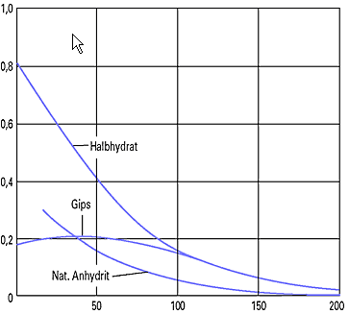
Hemihydrate and anhydrite III have a higher solubility compared to gypsum and natural anhydrite
Anhydrite III
Solved CaSO₄ [%]
hemi-hydrate
gypsum
nat. anhydrite
Temperature [°C]
36

Slide 37
The optimum gypsum content in the cement has to be determined on industrial scale
Increase addition of set regulator
Set point maximum standard SO₃
Stop addition of set regulator to mill
Take samples every 5 to 10 min over 30 to 60 min (frequency and duration depends on mill type/system)
Sample quantity according to scope of testing (5-20 kg)
Test samples with different SO₃ content for selected properties
at least: setting times, mortar compressive strength
ideal concrete: workability, compressive strength
37
Notes:
Min 5-6 samples are required to conclude on optimized SO3
Do not do the test when the Silo is empty!!

Slide 38
The optimum gypsum content in the cement has to be determined on industrial scale
Industrial SO3 optimization should be done:
for each cement type
for each mill system
after significant changes of
clinker composition (i.e. C₃A content, A/S ratio)
cement composition (e.g. increase of MIC content)
process temperatures (e.g. improvement of mill ventilation)
38

Slide 39
The dosage of the set regulator has a strong influence on strength development (example pozzolana cement)

Slide 40
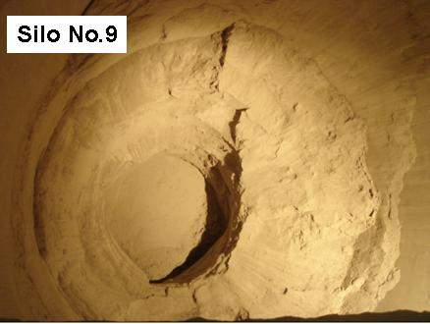
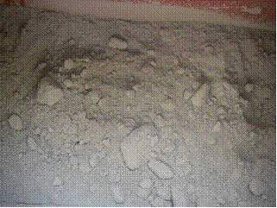
At high cement temperatures, gypsum can dewater in the silo leading to problems with lump formation
Solid blocks
Soft lumps in cement
Lump formation can be caused by:
High product temperatures at silo entrance and subsequent gypsum dehydration
Leakages in the silo walls
Excessive water injection into the mill
40

Slide 41

Principle of lump formation
CaSO₄ x 2 H₂O
Water entering the silo
Leakages
Gypsum
Moisture of water injection
“Bridging” phases are formed
Ettringite
Syngenite
Consequence
Loss of flowability
Lump/build up formation
Pre-hydration (retardation, strength loss)
> 80 °C
CaSO₄ x 0.5 H₂O + 1.5 H₂O
Side of coating formation
41
Product Optimization, CM-MMT, LAF, 2014-10-28

Slide 42
Measures to avoid lump formation
Keep cement temperature below 75/80°C in order to avoid dehydration of gypsum
Avoid grinding of hot clinker
Optimize air ventilation
Inject water into one or both grinding chambers
Install cement cooler
Reduce water input via gypsum
Partial or complete substitution of gypsum by anhydrite
Optimize gypsum for each cement type (avoid overdosing)
Avoid water penetration
Control silo roof, walls
Adequate silo ventilation
Reduce storage time
Empty silos regularly
42
Notes:
Most of the time, Gypsum is cheaper

Slide 43
Measures to avoid lump formation (cont.)
Adjust clinker properties
Balance alkali sulfur ratio (no high reactive C₃A)
Reduce K₂O content (avoid syngenite formation)
Adjust adequate free lime (“water absorbant”)
Improve cement flowability
Use cement additives to improve flowability
Adjust cement fineness (flowability improves with higher fineness)
43
Notes:
Adjust adequate free lime (in case CaOf level is low)

Slide 44
A sampling campaign helps to understand the origin of the lump formation problem
Take samples at mill outlet and silo inlet; silo outlet samples shall be taken during dispatch
Take temperature of cement at mill exit and silo inlet
Investigate moisture content in the samples by differentiating
Inherent moisture
Gypsum/Hemihydrate water
Syngenite
Portlandite/C-S-H water
44

Slide 45
Methods to determine the dehydration degree and reasons for lump formation
Temperature range | Type of moisture
20 – 70 °C | inherent moisture (water spray, water ingress)
70 – 250 °C | gypsum, hemihydrate crystal water
250 – 600 °C | Syngenite, portlandite crystal water
Staggered LOI
Easy and cheap
Gypsum and hemihydrate cannot be distinguished
In the end sample should be heated up to 950 °C to get complete LOI (plausibility check)
45

Slide 46
Methods to determine the dehydration degree and reasons for lump formation
Thermal analysis - (Thermal Gravimetric Analysis)/ (Differential Scanning Calometry)
Differentiation between gypsum and hemihydrate (anhydrite to be calculated)
Identification of hydration products (Portlandite, ettringite) and typical bridge forming minerals (syngenite)
Equipment not available in most plants
XRD
Differentiation of gypsum, hemihydrate, anhydrite
Identification of hydration products and typical bridge forming minerals (syngenite)

Slide 47
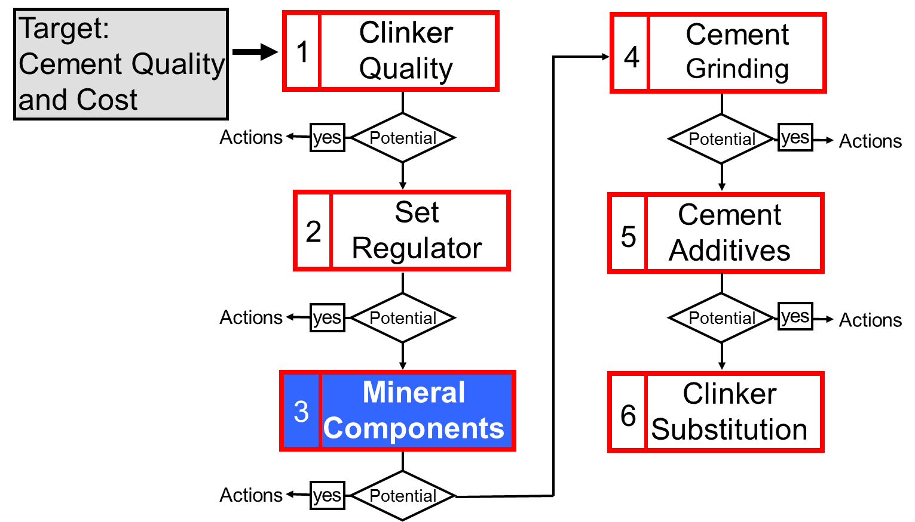
Systematic approach for product optimization
47

Slide 48
Mineral Components

Slide 49
The use of Mineral Components (MIC) can have several positive effects…
Reduction of clinker factor
Improved late strength
Improved durability
Frost resistance
Higher resistance against acid attack
Lower risk of alkali silica reaction
Improved workability
Lower water demand
Better grindability
49

Slide 50
…but due to the lower clinker factor composite cements suffer from a low early strength.
60
60
50
50
40
40
Strength [MPa]
Grinding energy [kWh/t]
30
30
20
20
10
10
MIC content: 21 - 35 %
0
0
OPC
Limestone
Pozzolan
Fly ash
Gbfs
2 d
27.1
16.8
16.9
12.0
19.4
28 d
48.9
36.5
37.7
41.8
45.8
Energy
46.7
33.4
33.0
39.5
43.4
Blaine
3825
4110
3977
3704
3785
Source: ATR 2001
50

Slide 51
The typical MIC dosages depend on the cement application and standard limits.
 | General purpose | Sulfate resistance | Low heat of hydration | Chemical resistance*
 | Weight %
Blast furnace slag | 25 – 40 | 70 | 50 | 60
Fly ash (class F) | 15 – 30 | 30 | 30 | 40
Natural pozzolans | 15 – 30 | 30 | 30 | 40
Limestone | 10 - 25 | n.a. | n.a. | n.a.
* Provided that the w/c-ratio of concrete is reasonably low
51
Notes:
Chemical resistance for higher acid concentration (ex: agricultural building)

Slide 52
Mineral components can be classified by their reaction mechanism
SiO₂
Silica fume
Inert
Natural pozzolan
Increasing Reacitivity
Pozzolanic
ClassF fly ash
Meta-kaoline
Class C
Fly Ash
Latent hydraulic
BFS
OPC
Hydraulic
Lime- stone
CaO
AI₂O₃
52

Slide 53
The optimization of MIC is often not in the hands of the cement plant
Limestone
Usage of good quality limestone without clay and organic contamination
Natural pozzolan
Selective mining according to pozzolanic activity
Pre-homogenization
Granulated blast furnace slag (GBFS)
Optimization of slag quality at blast furnace or granulator (e.g. Al₂O₃-content, basicity, glass content)
Fly ash
Selection of fine fly ash from filter of power station
Beneficiation (extraction of un-burnt, coarse particles)
53

Slide 54
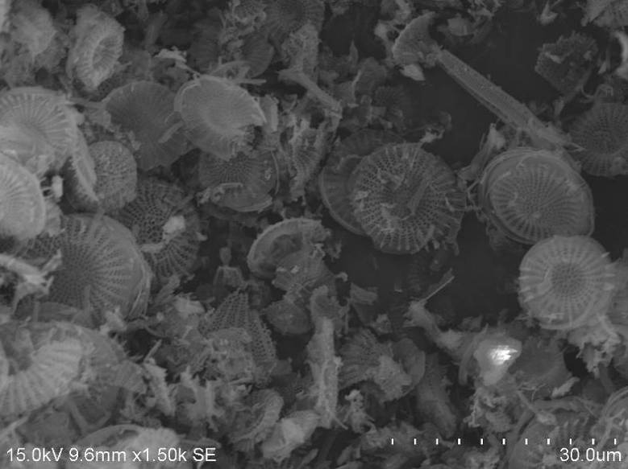
Characterization of natural pozzolan
Parameter | Reverences / limits
Relevant standards | EN 197-1 ASTM C311
Chemical composition
Desirable: SiO₂ + Al₂O₃ + Fe₂O₃ | >70%
Mineralogical composition
Desirable: glass, zeolite Critical: clay (water demand) | > 50%; > 20%* < 10%
Hydraulic activity
Strength activity index Pozzolanicity test (Ca(OH)₂) Pozzotech WP13 | >75% EN 196-5
54

Slide 55
Example: Upgrading pozzolan quality at Nobsa
1st step: Selective Mining based on Pozzolanic Activity
2nd step: Pre-blending of Pozzolan
Result:
Source: Jairo Hernandez, Cem.Boyacá
55

Slide 56
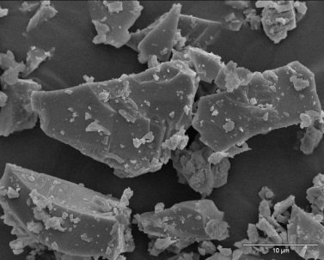
Relevant GBFS parameters
Parameter | References/ limits
Relevant standards | EN 197-1 ASTM 989
Chemical composition
Desirable: CaO,MgO, SiO₂ Basicity, e.g.(C + M)/S Critical: SO_{3,} S²⁻ TiO₂ Heavy metals | min. 2/3 min. 1.0 < 4.0 %, < 2.5 % Ideal < 0.5%
Mineralogical composition
Glass content | min. 2/3 (ideal > 90%)
Hydraulic activity
Strength activity index | ASTM C 989
56

Slide 57
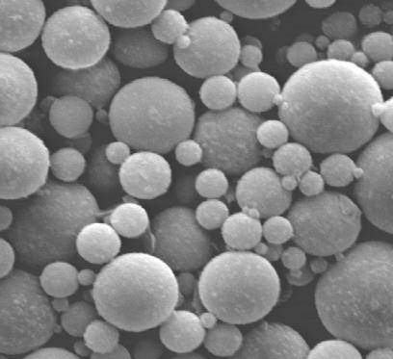
Characterization of fly ash
Quality characteristics | References and limits
Relevant standards | EN 197-1 ASTM C618
Chemical composition
Desirable: SiO₂, Al₂O₃,(CaO), Fe₂O₃ Critical: SO_{3,} Carbon (LoI) | max. 5%
Mineralogical composition
Desirable: glass Critical: CaO free | > 25% (typical 50-80%) < 1% EN 197
Hydraulic activity
Activity index Pozzolanicity test (Ca(OH)₂) | ASTM C 311 EN 196-5
Granulometry
Spherical particles Fineness
57

Slide 58
Use of kiln dust in the cement
Kiln dust that cannot be recycled in the kiln system should be added to the cement (when allowed by the standards)
Bypass dust
Dust of long kilns and Lepol kilns
It is recommended to use filter dust collected during direct operation in the cement to reduce cycles of highly volatile elements (Hg, Tl, Cd, Cl)
Bypass dust usually contains high concentrations of alkalis and sulfur
can increase early strength
Limiting factor is usually the limit (Cl < 0.1 %) in cement
Handling and dosing are critical, due to stickiness of the material
Element | Average | Maximum
K2O | 10.5 | 25.0
Na2O | 2.5 | 4.1
SO3 | 8.7 | 16.5
Cl | 5.5 | 9.5
58

Slide 59
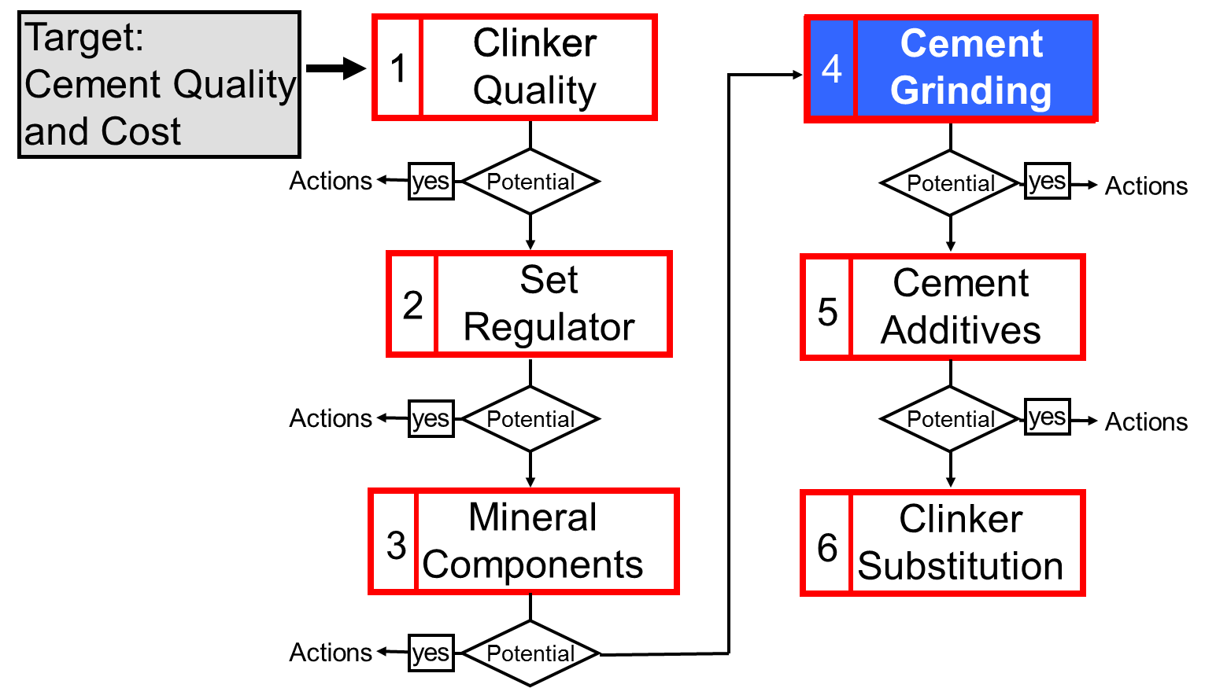
Systematic approach for product optimization
59

Slide 60
Cement Grinding

Slide 61
Besides the properties/proportioning of components, the grinding process has a strong influence on cement quality
Fineness / particle size distribution (PSD)
Water demand and setting behavior
Strength development
Grinding temperature / residence time (dehydration of gypsum)
Setting behavior
Flowability / storage stability
Trends with modern grinding systems (e.g. vertical mills)
Narrower particle size distribution
Lower grinding temperatures and residence time (less dehydration of gypsum and lower contents of easily soluble sulphates)
61

Slide 62
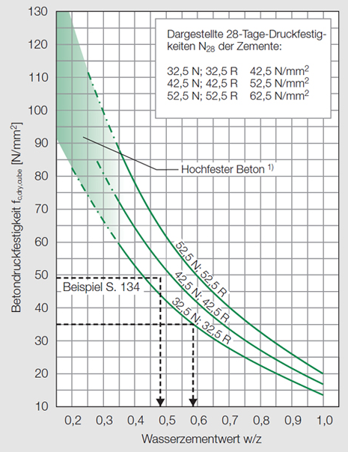
High water demand has a negative influence on strength
Water demand to achieve a certain flow depends on:
Reactivity of cement constituents (clinker)
Water demand of cement constituents (e.g. pozzolan, silica fume)
Cement fineness (finer -> higher water demand)
PSD of cement (narrower -> higher water demand
Concrete composition (cement content, aggregate composition…)
62

Slide 63
Workability: Water is required to fill the voids among the cement particles
Water needed for early hydration products
Water demand
Water needed to fill void volume
characteristic diameter x’
fines
63

Slide 64
Strength development is determined by the reactivity and fineness of the cement constituents
Clinker fineness:
Ideal for high strength
%
Particle size (μm) | Main influence on:
0 – 3/10 | 1d strength
3/10 – 25 | 28d strength
25 – 50 | 90d strength
not ideal
3 μm
30 μm
μm
Ideal clinker PSD to achieve maximum reactivity
High fraction < 30 μm
High fineness
Narrow PSD. For the resulting cement, however, a wide PSD is better (workability)
64

Slide 65
In compound grinding the cement components are distributed according to their grindabilities
Soft MIC (e.g limestone, pozzolan)
Hard MIC (e.g. GBFS)
%
%
Clinker
Clinker
MIC
MIC
μm
μm
Broad PSD of cement
MIC concentrated in fine fraction
Clinker in coarse fraction
Narrow PSD of cement (high water demand)
Similar PSD of clinker and MIC
65

Slide 66
The following measures can be applied to improve cement fineness and particle size distribution
Optimization of tube mill performance
Adjustment of ball charge
Adjustment of material level in the first chamber
Adjustment of the circulation load
Use of modern grinding technologies (high efficiency separator, semi-finish grinding, vertical mill)
Separate grinding of clinker and MICs
66

Slide 67
Separate grinding of clinker and MIC gives more flexibility for the optimization of the particle size distribution
Materials with different grindabilities: Effects on the product particle size distribution
Compound grinding
Separate grinding
soft
hard
67

Slide 68
Separate grinding can give significant potential for CF reduction depending on the specific plant situation
Potential for CF reduction through separate grinding of clinker and MIC typically in the order of 5%
Best case examples for CF reduction with separate grinding
Application of separate grinding is limited to plants with certain flexibility in production facilities
Plant | Cement Type | CF Reduction (%)
Barroso | Slag cement | 16
Cantagalo | Slag cement | 13
Cartago | Pozzolanic cement | 10
68

Slide 69
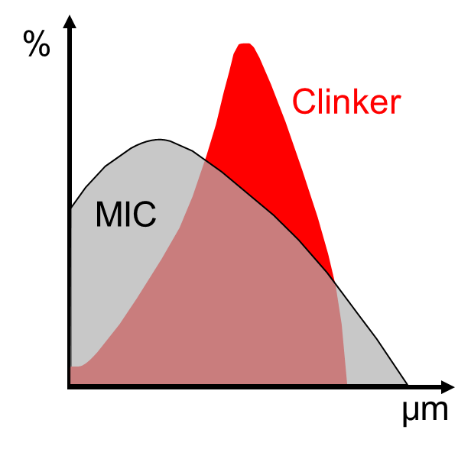
For composite cements, the fineness control is to be based on sieve residues (and not on Blaine)!!
Soft MIC (e.g limestone, pozzolan)
The residue in composite cements is in general clinker
For blended cements:
Always control fineness on basis of sieve residue!
In particular when using soft MIC
Blaine
Mainly influenced by very fine particles
Increase of MIC proportion can increase Blaine significantly
69

Slide 70
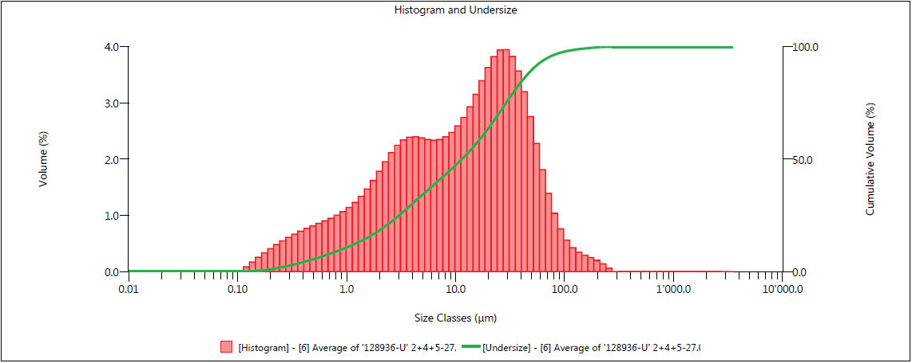
Laser granulometry helps to get a clearer picture of the cement psd
Note: We get a Volume distribution!
100-R5
d50
Density distribution q₃
Cumulative distribution, Q₃
Information which is directly accessible:
Residues [%], like R15, R20, R32, R63.3, etc. almost continuous.
Position parameters [μm], like d10, d50, d90
70

Slide 71
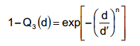
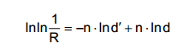
Evaluation of the RRSB parameter
The RRSB distribution is given by a mathematical function, described by two parameters:
The position parameter d’ (or x’)
The slope or steepness parameter n
Experience has shows that it (often) fits quite nicely to particle size distributions produced by comminution processes.
Double logarithm yields the function of a line, which can be plotted in the RRSB diagram.
Practical interpretation:
d’: position parameter [μm] with 63.2% passing
n: slope of the line in the RRSB diagram. The higher the slope the narrower the distribution.
71

Slide 72
RRSB Diagram
99.9
99.9
There are different methods of evaluation
Typically the lowest and the highest 10% of the distribution are not considered
99
99
95
95
Passing [%]
90
90
80
80
63.2
63.2
50
50
40
40
30
30
n = 0.74
20
n = 0.74
20
x
x
‘
‘
= 19.6
= 19.6
µ
µ
m
Slope
m
10
10
Char. Diameter
5
5
4
4
3
3
2
2
1
1
1
1
1.5
1.5
2
2
3
3
4
4
6
6
8
8
12
12
16
16
24
24
32
32
48
48
64
64
96
96
128
128
200
200
Particle size [um]
72

Slide 73
The n parameter is a often function of the grinding system and the cement constituents
n (HRM) > n (VRM) > n(BM)
73

Slide 74
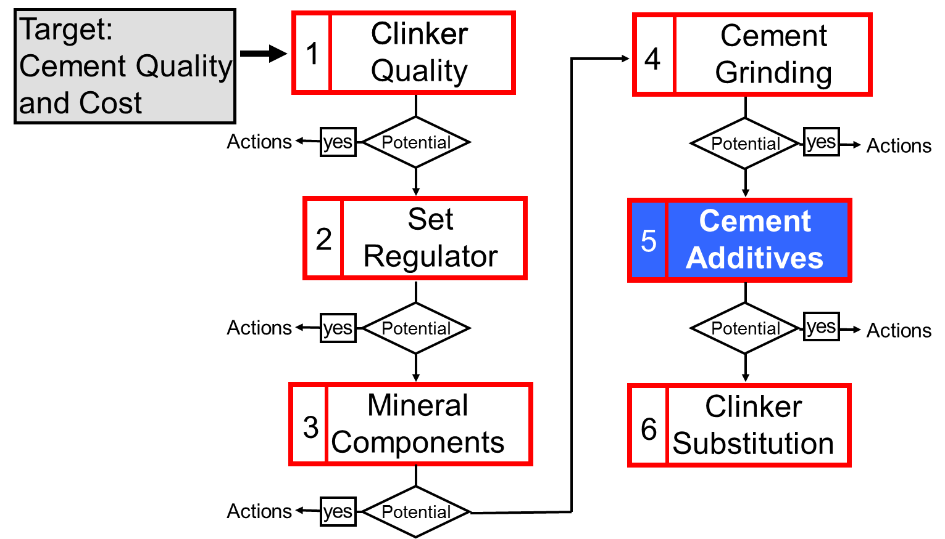
Systematic approach for product optimization
74

Slide 75
Cement Additives

Slide 76
Cement additives are used for the purpose of process and product optimization and for the production of special cements
Type of Additives | Cost / Dosage* | Purpose
Grinding aids (Process improvement related) | 0.1-0.4 USD/t 100 – 500 g/t | Reduction of specific energy consumption Improvement of mill output Reduction of pack set (better flowability)
Quality improvers (Product properties related) | 0.5 – 1.0 USD/t 300 – 5000 g/t | Grinding aid and strength enhancer Clinker factor reduction Water reduction
Others (Particular properties related) | Up to 5000 g/t Up to 500 g/t Up to 2000 g/t Up to 2000 g/t | Cr(VI) reduction Air entrainment Retardation Water retention
* indications per t of cement
76

Slide 77
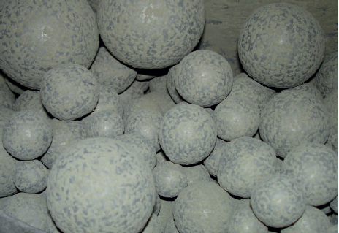
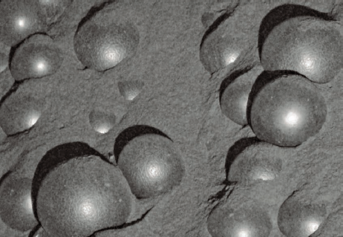
Additives reduce the trend of the ground particles to agglomerate
Additives reduce the inter-particle forces
Reduced coating of grinding balls and mill internals
Better dispersion of particles in separator feed
Reduction of mill filling level (decrease of residence time)
Improved flowability of cement
Coating
Agglomeration
Dis-Agglomeration
Clean grinding balls
Source: Grace
77

Slide 78
Depending on the type of product, a variety of cement additives can be applied during cement grinding
Cement type | Grinding aids | Quality improvers |  |  | Others
 |  | Strength enhancer | Water reduction | Set control | Air entrainer | Water retention
OPC | typical | possible
OPC white | typical |  |  | possible
Limestone cement | typical | typical
Masonry cement |  |  |  | possible | possible | typical
Fly ash / pozzolan cement | possible | possible | possible |  | possible
Blast furnace slag cement | possible | typical
Cement for self compacting concrete | possible |  | typical | possible |  | typical
Note: Cr[VI] reducers can be applied for all cement types depending on the requirements
78

Slide 79
Trials with cement additives are particularly indicated under the following circumstances
Grinding aids (typical potential: 5 - 10% higher mill output or lower electrical energy)
Bottlenecks in cement grinding capacity, unfavorable electricity tariffs.
High specific electrical energy consumption during cement grinding (e.g. > 45 kWh/t).
“Pack set” problem, problems with cement handling.
Quality improvers (typical potential: 2 - 3% reduction in clinker factor)
Opportunity for further clinker factor reduction (increase of cement volumes, cost and CO₂ reduction).
Cement setting or strength development problems.
Others:
Production of special cements/binders with better margins (masonry cement, road binder, …).
79

Slide 80
In order to get comparable data, a procedure for plant trials was established consisting of different steps
Preparation
Laboratory testing of additives
Pre-selection of additives for the trials
Industrial trials
Step 1: Short term trials 6 - 8 h each
Step 2: Short term trials 6 - 8 h each
Step 3: Long term trial ideally 1 month
Benchmarking of different additives
Testing best additive
Proving suitability of additive Final evaluation
Constant fineness
Constant composition
Variation of additive dosage and type
Variation of:
Cement composition
Cement fineness
Additive dosage
Slow adjustment of:
fineness
composition
if necessary to keep quality
Selection of best suited additive
Optimization of quality/ production rate
Validation of results
Evaluation of potential downstream impacts
Step 4: Check of additive effectiveness
Periodic short term trials (e.g. every 6 month)
80

Slide 81
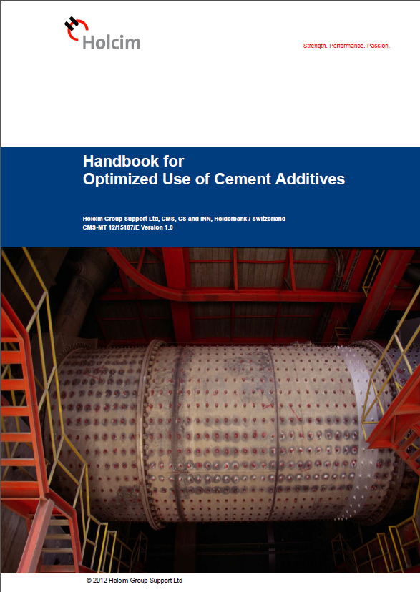
Best practices for the use of cement additives have been recently summarized in a handbook.
Content
Market assessment
Additive testing on industrial scale
Planning
Execution
Mill operation
Downstream impacts
Additive effect and control
Standard requirements
Chemical ingredients and their effects
Lab testing of new additives
Quality control in routine application
Commercial viability of test results
Can be found on Google Drive
81

Slide 82
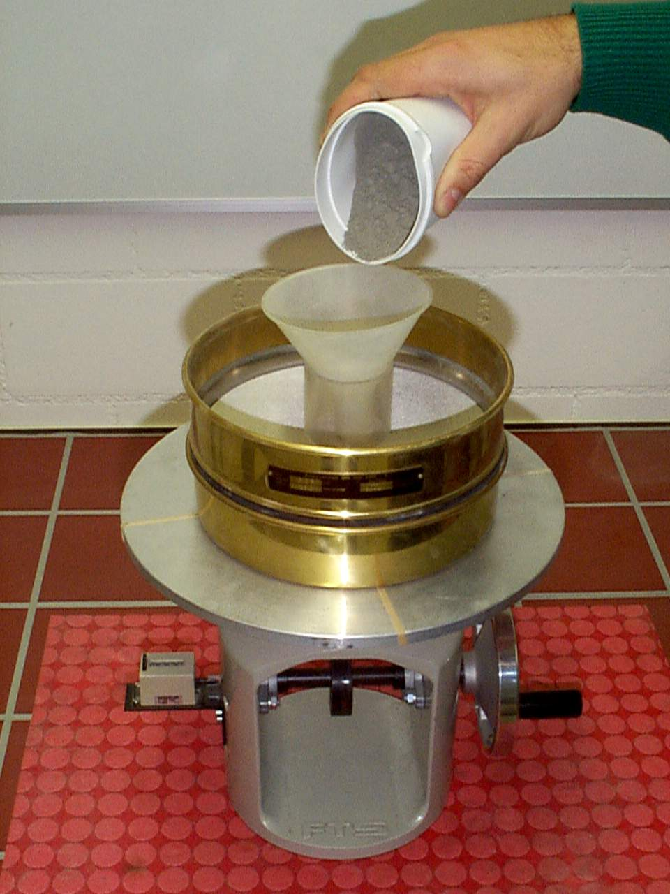
Flowability of the cement with additives can be determined by a simple test using a sieve and a shock table.
Test result:
Passing of cement through sieve
Screen Grid Width
Grinding Aid
E. R.
0.25 mm
0.50 mm
Without GA
0%
9%
29%
Amine based
12%
19%
46%
Glycol based
11%
9%
31%
E. R. = Reduction in spec. energy demand at 4000 cm²/ g (Blaine)
Tools needed:
Sieve & Shock Table
Further references:
PCA Info: http://www.cement.org/manufacture/man_packset.asp
ASTM C1565-04 Standard Test Method for Determination of Pack-Set Index of Portland Cement
82

Slide 83
Chromium reduction – why and where?
EU directive requires a limit of 2 ppm soluble CrVI in order to reduce the risk of chromium eczema
CrVI is formed during clinker burning
Composite cements have generally lower CrVI concentrations (dilution)
Usually the CrVI content is higher than 2 ppm
Typical reducing agents
Iron sulfates (hepta/tetra/mono hydrate)
Tin sulfates
Typical costs between 0.5 – 1.0 €/t
Optimum dosing point depends on type of agent
83

Slide 84
Conclusions

Slide 85
Conclusions
Continuous and systematic Product Optimization is a key measure to achieve cost and market leadership and to fulfill CO₂ targets.
Product Optimization can not just be left to the quality assurance department, it requires combined effort of the plant and line management.
Cement plant must ensure effective communication and cooperation with marketing and sales
to be aware of market requirements
to bring forward producers’ interests
to assure optimal product mix and quality targets
85

Slide 86
General messages for product optimization
Optimization of clinker quality comes always first (clinker is finally the most essential ingredient in the cement and it is under our control).
Actions for optimization are to be carried out step by step, in order have a clear picture on the effects (do not change several parameters at once).
A sufficient duration of the optimization tests is to be ensured, in order to obtain representative results.
All the realized tests have to be properly documented (incl. process data) for further reference.
86

